Slide 1
INTRODUCTION TO MARKETING
0
Chapter 3
The Cultural
Environment
NGUYEN THI PHUONG*
THANG LONG UNIVERSITY
*MA in Global Marketing, PHD in Economics

Slide 2
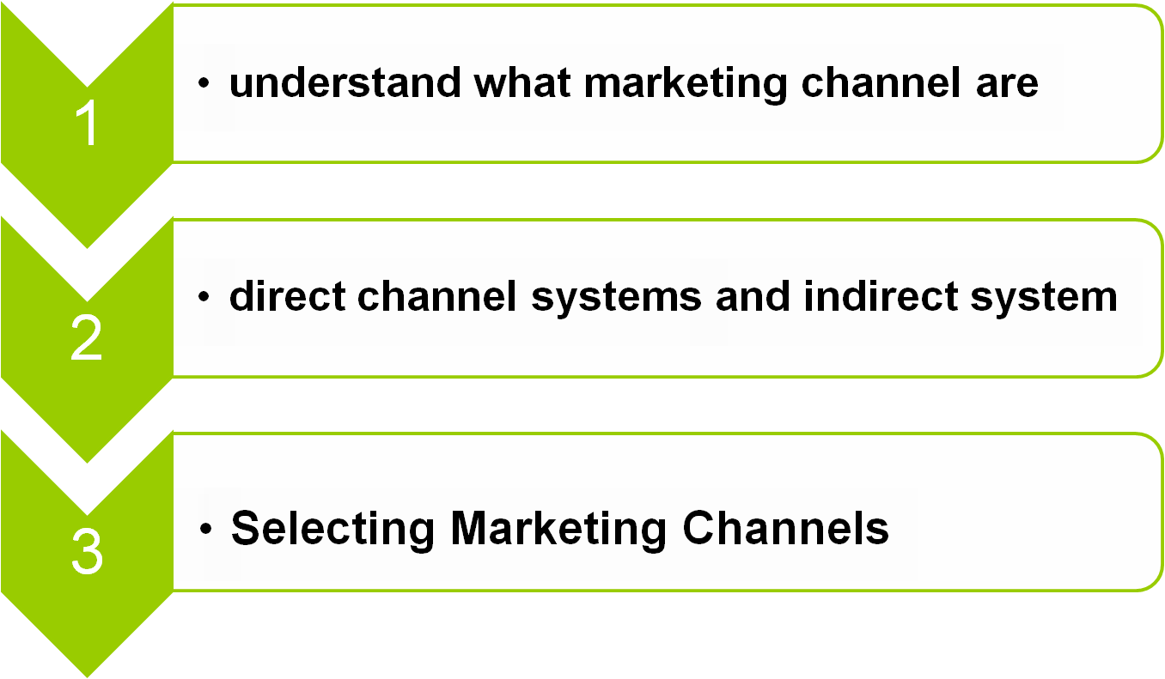
SESSION 11: Marketing channels
Copyright © 2011 Pearson Education
15-<number>

Slide 3
11.1 Marketing channel definition
A marketing channel is a set of practices or activities to transfer the ownership of goods from the point of production to the point of consumption which consists of all the institutions and all the marketing activities in the marketing process
4 types of marketing channels:
direct selling
selling through intermediaries
dual distribution-phân phối kép
and reverse channels-kênh ngược
Copyright © 2011 Pearson Education
15-<number>

Slide 4
11.2 Direct selling
Direct selling is action of marketing and selling of products directly to consumers away from a fixed retail location. Peddling (bán rong) is the oldest form of direct selling.
Modern direct selling includes sales made through the party plan, one-on-one demonstrations (sự bày tỏ), and personal contact arrangements as well as internet sales
For example, website based e-commerce system
Copyright © 2011 Pearson Education
15-<number>

Slide 5
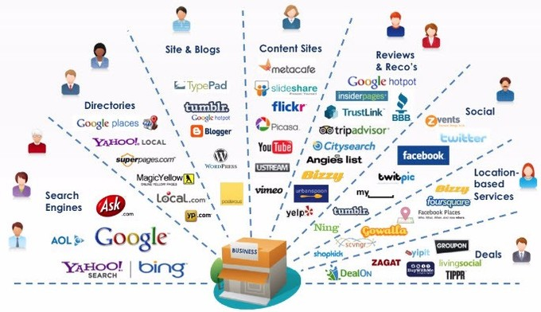
Digital Channel (Kênh kỹ thuật số)
Copyright © 2011 Pearson Education
15-<number>

Slide 6
Direct selling is different from direct marketing
Direct selling is about individual sales agents reaching and dealing directly with clients
Direct marketing is about organizations seeking a relationship with their customers without going through an agent/consultant or retail outlet (cửa hàng bán lẻ).
Copyright © 2011 Pearson Education
15-<number>

Slide 7
11.3 Selling Through Intermediaries
A marketing channel where intermediaries such as wholesalers and retailers are utilized to make a product available to the customer is called an indirect channel.
The most important reason for using an indirect channel of distribution is that an intermediary can often help producers serve customer needs better and at lower cost
indirect channel: (Producer/manufacturer –> agent –> wholesaler –> retailer –> consumer)
Copyright © 2011 Pearson Education
15-<number>

Slide 8
11.4 Dual Distribution
Dual distribution describes a wide variety of marketing arrangements by which the manufacturer or wholesalers uses more than one channel simultaneously to reach the end user. They may sell directly to the end users as well as sell to other companies for resale.
Example: business format franchising, where the franchisors, license the operation of some of its units to franchisees while simultaneously owning and operating some units themselves.
Copyright © 2011 Pearson Education
15-<number>

Slide 9
11.5 Reverse Channels
Each one flows from producer to intermediary (if there is one) to consumer. Technology, however, has made another flow possible.
This one goes in the reverse direction and may go from consumer to intermediary to beneficiary.
For example, making money from the resale of a product or recycling.
Copyright © 2011 Pearson Education
15-<number>

Slide 10
11.6 Selecting Marketing Channels
Before selecting which marketing channels are ideal for a given organization, it’s important to understand:
Consumer Preferences: the consumer’s habits and behaviors determine channel strategy more than anything else. For example, If a movie studio knows that the majority of their customers rents films via iTunes, they may want to create a strategic alliance with Apple.
Copyright © 2011 Pearson Education
15-<number>

Slide 11
Cost: directly selling eliminates organizations between the user and the producer, and therefore can be even lower cost but buying a small quantity of goods (consider shipping, storing and other logistics). Wholesalers are willing to buy large shipments of goods, but usually at a significant discount.
Copyright © 2011 Pearson Education
15-<number>

Slide 12
  Brand: Organizations create strategic alliances to build channels for consumers, and these alliances will reflect on the overall branding initiatives of both partners
Localization: it is also useful to localize and enter new markets through effective marketing channel selections.
Copyright © 2011 Pearson Education
15-<number>

Slide 13
Homework
1. List marketing channels of dairy products
Copyright © 2011 Pearson Education
15-<number>

